Slide 1

Strings

Slide 2
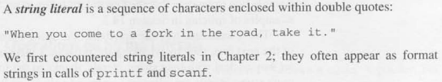
String Literals

Slide 3
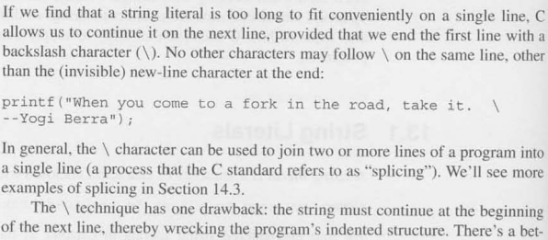
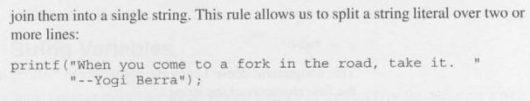
Counting a string literal

Slide 4
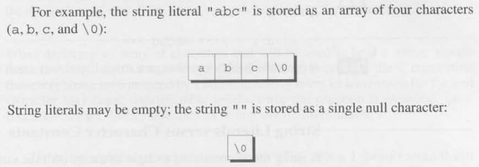
How are string literals stored?

Slide 5
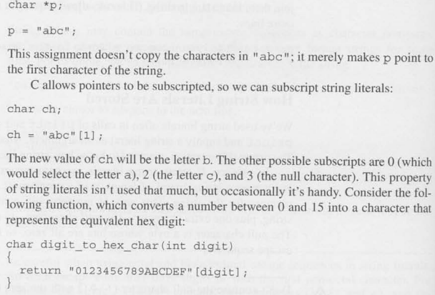
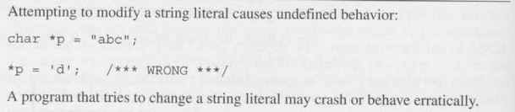
Operations on string literals

Slide 6


String Variables & Initialization

Slide 7
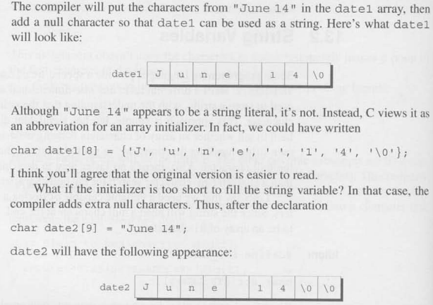
String Initialization

Slide 8
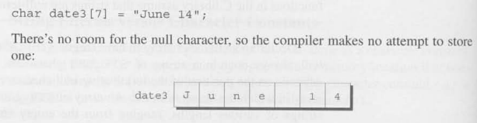

String Initialization

Slide 9
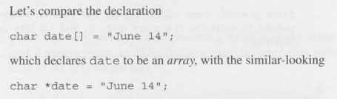

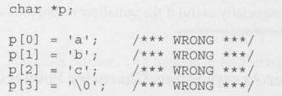
Character arrays vs Character pointers

Slide 10
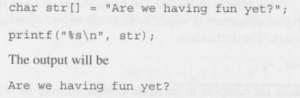


Writing Strings: Printf & Puts

Slide 11

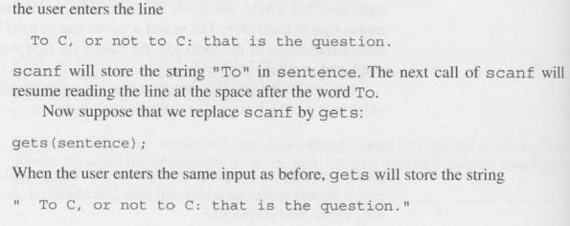
Reading Strings: scanf & gets

Slide 12
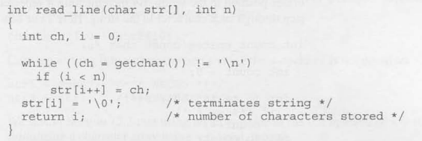
Reading Sting Character by Character

Slide 13
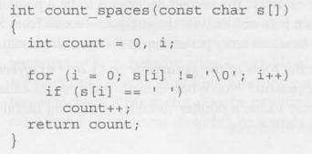
Accessing the characters in array

Slide 14
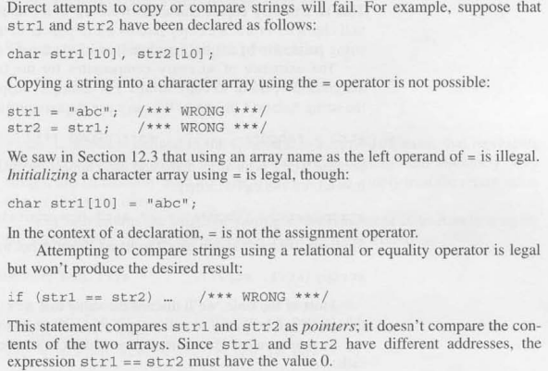
Using the C string library

Slide 15

Using the C Sting library
strcpy ()
strncpy ()
strlen ()
strcat ()
strncat()
strcmp()

Slide 16

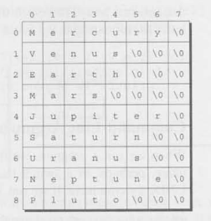
Arrays of Strings

Slide 17

Command line arguments

